Slide 1
Abstract
Writing
Workshop
CAPjournal for CAP 2022
28 April @ 2pm UTC | 29 April @ 1am UTC

Slide 2
Workshop Agenda
Introduction
Introductions
Discussion – Why do we write papers? What is the function of an abstract?
Descriptive vs. Informative
Expectations from the SOC
Q&A
Break

Slide 3
Our submission process has changed…
Abstract or summary
Full article
Notes:
https://www.capjournal.org/submission.php

Slide 4
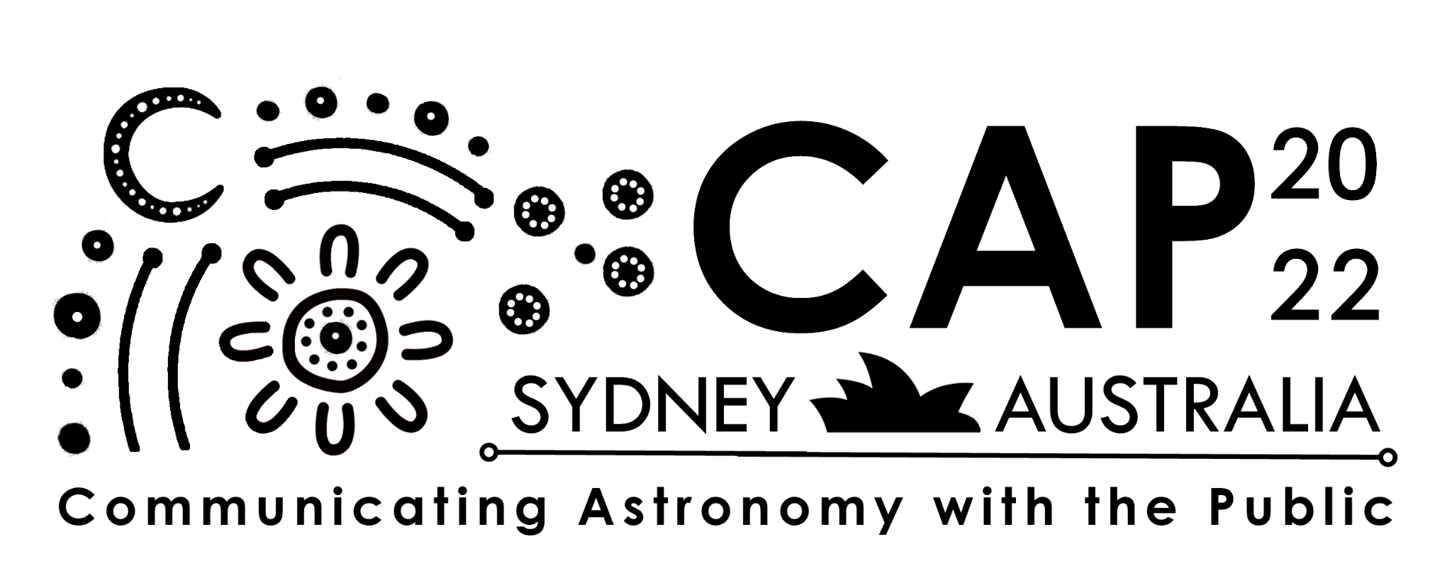
Notes:
https://capconferences.org/2022/registrationabstracts/

Slide 5
Notes:
https://capconferences.org/2022/registrationabstracts/

Slide 6
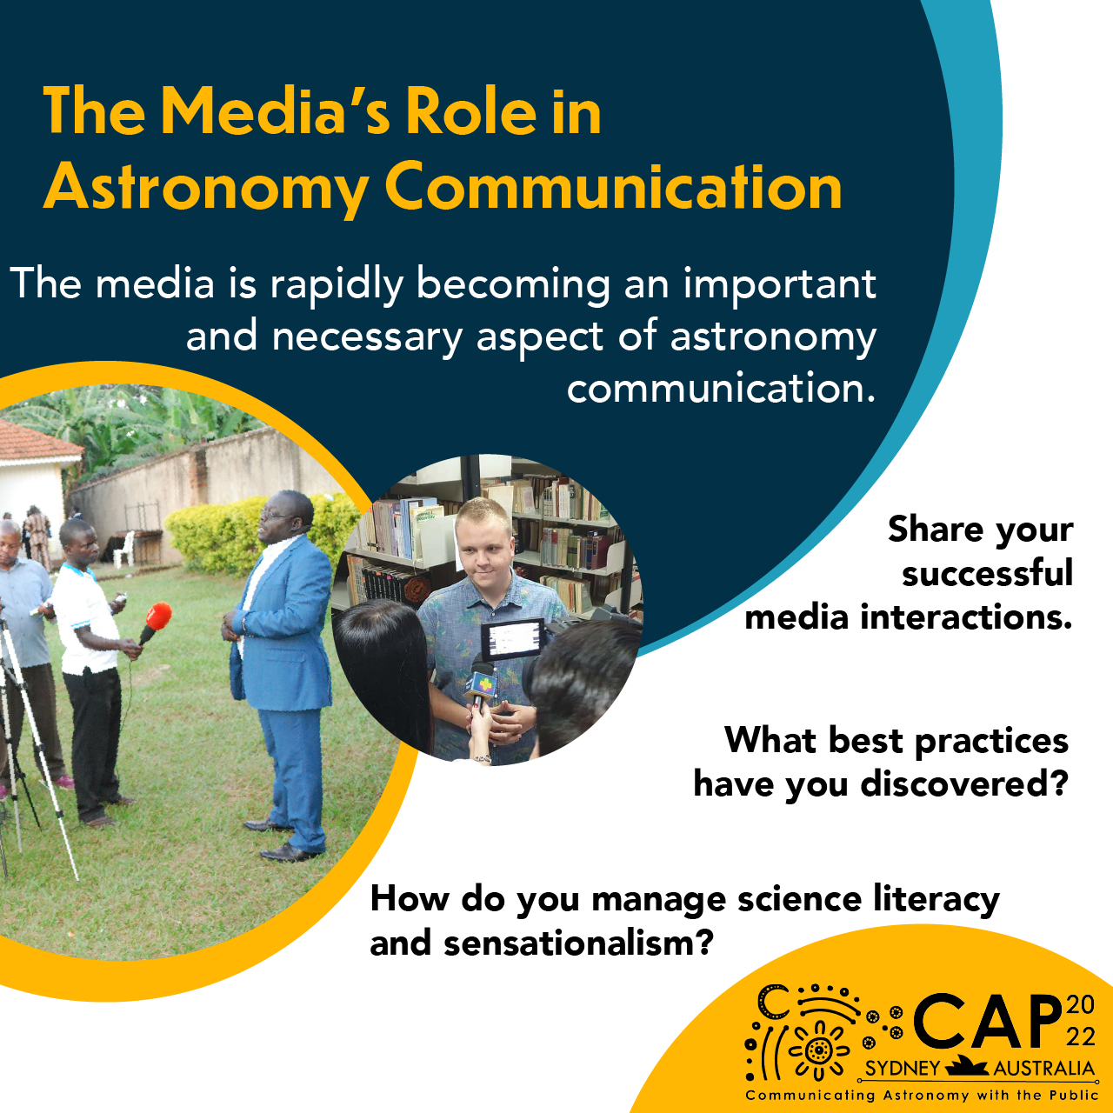

Slide 7
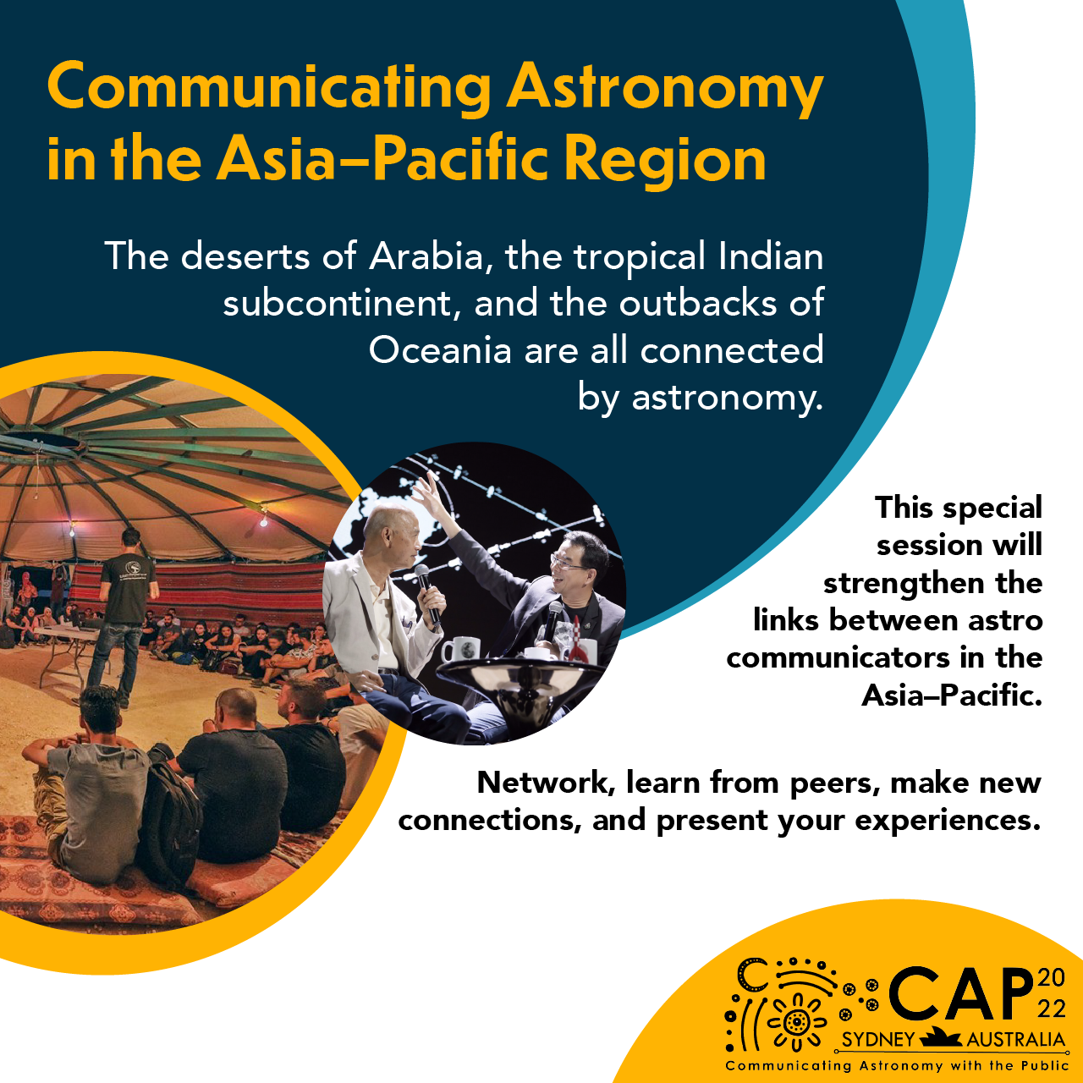
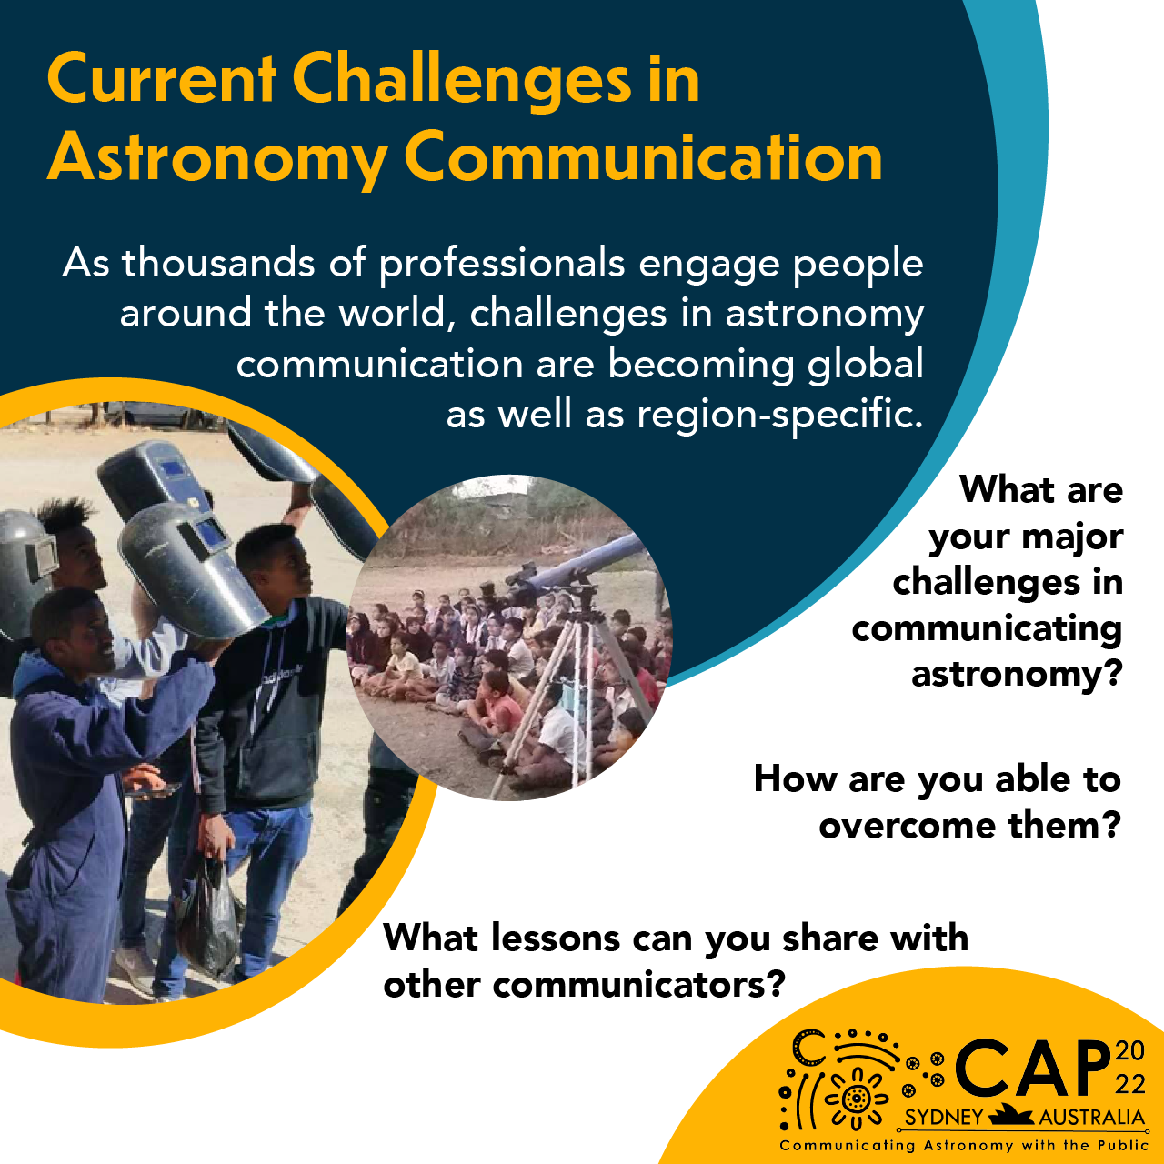

Slide 8
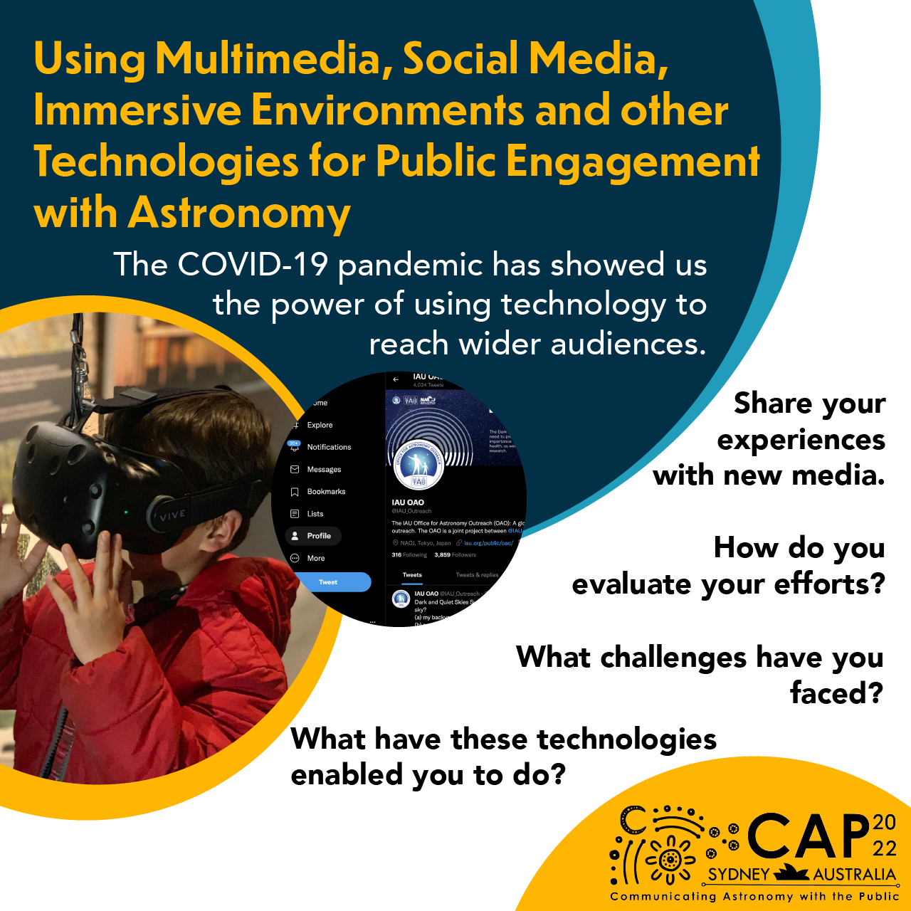
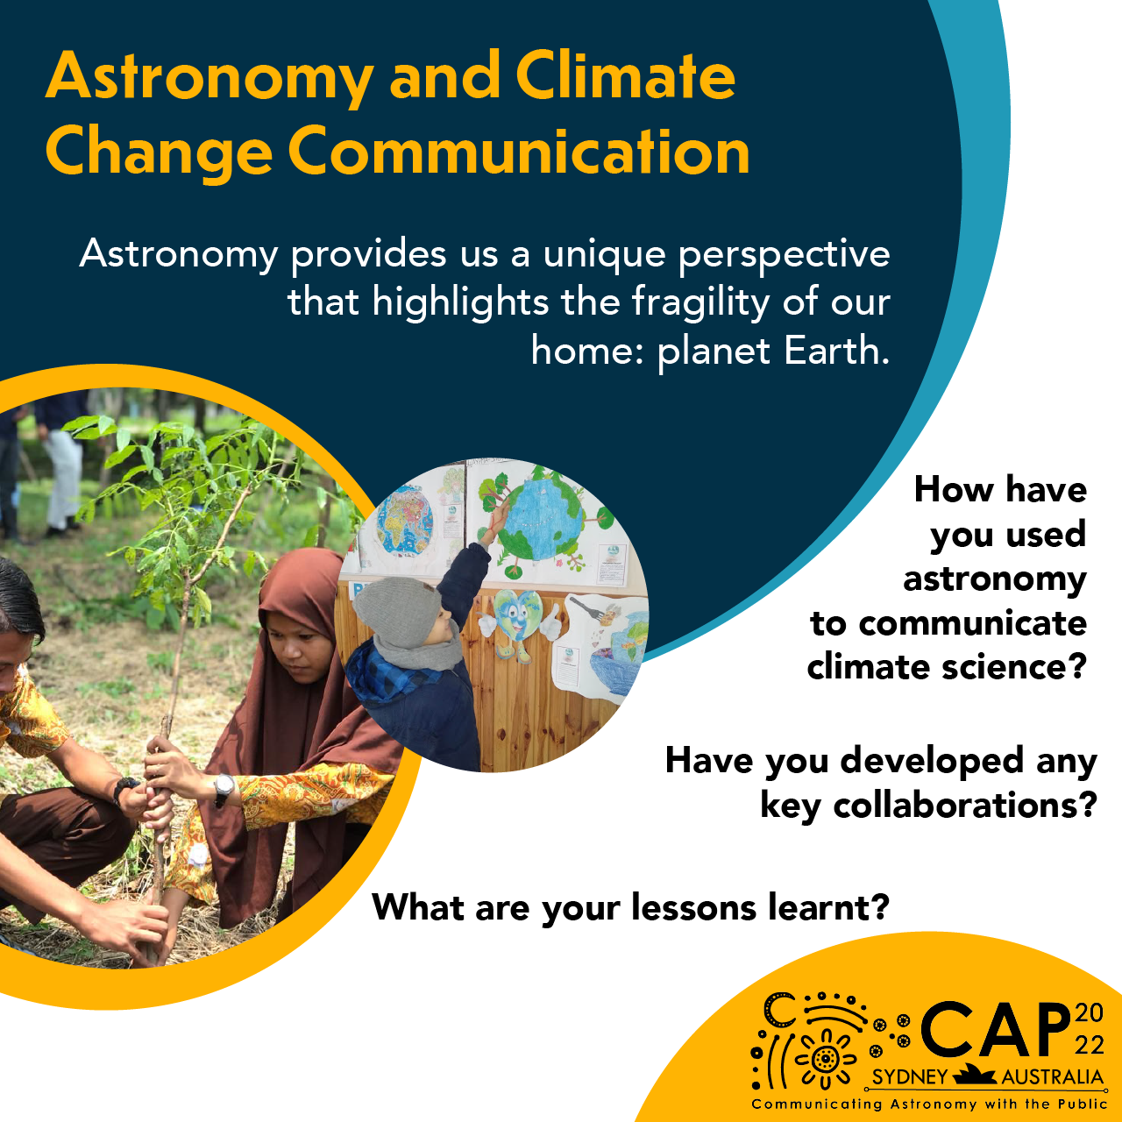

Slide 9
By the end of this workshop you will…
Know the different types of abstracts
Know the anatomy of an abstract
Create a list of do’s and don’ts
Understand the SOC’s expectations
Write an abstract outline

Slide 10
Disclaimer
Participation in this workshop does not guarantee
acceptance to CAP Conference or CAPjournal.

Slide 11
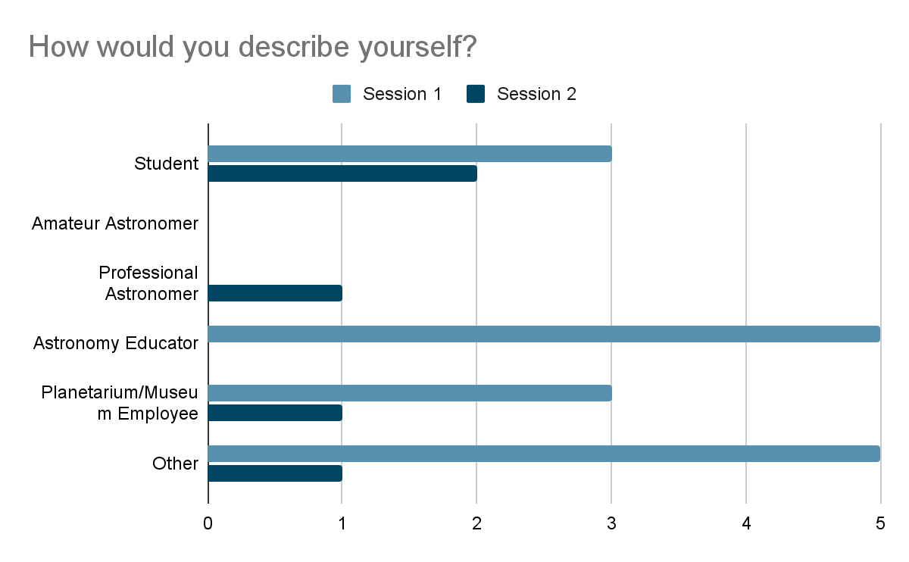

Slide 12
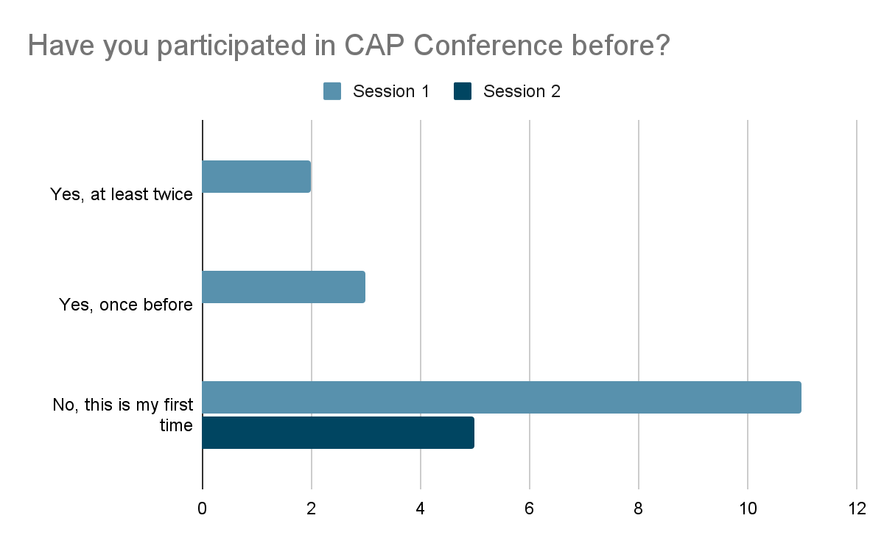

Slide 13
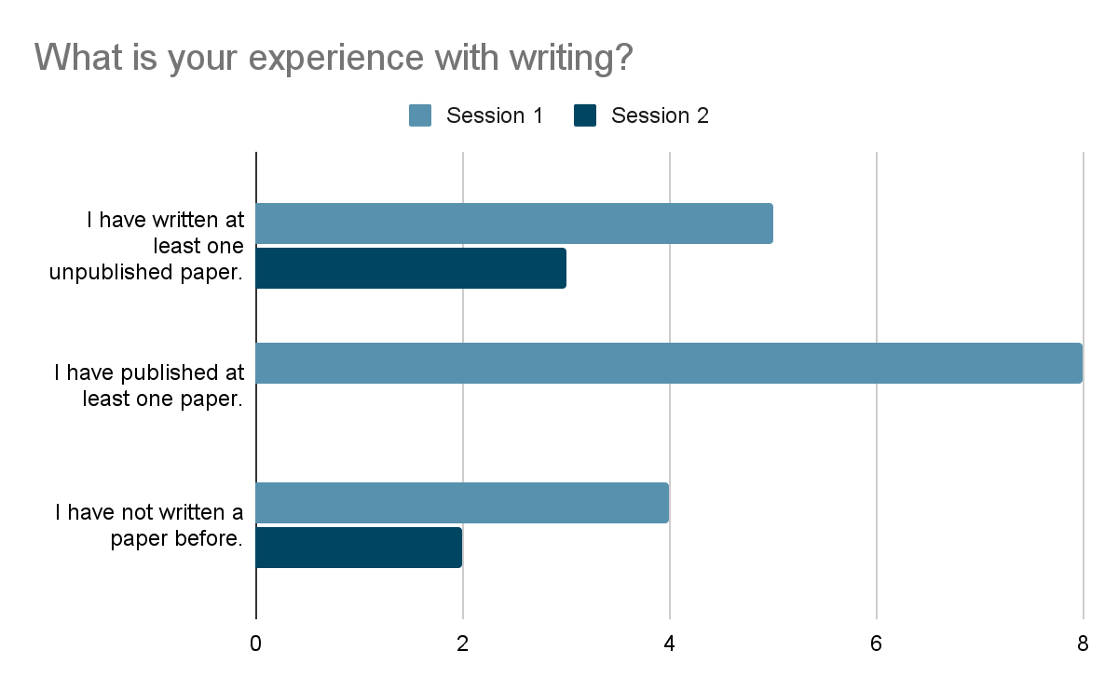

Slide 14
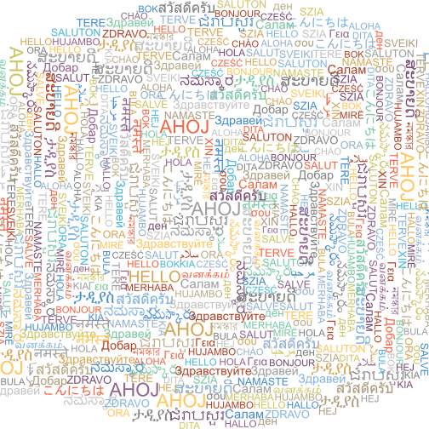
Introductions
Name
Affiliation/ Where you’re from
Read your 2 sentence description from the registration form

Slide 15
Poll: Why do we write papers?
record and Share experiences
To share your research, observations and results about a particular subject
To share impact of projects through number and statistics
to share knowledge and skills. OR findings
Brainstorm, archiving, scaling best practices
We write papers to inform people of a certain subject or study
To get the thoughts or experience recorded and to share and discuss with others
Share new findings with the world.
We write papers to transfer knowledge, inform others about our research.
To share information with colleagues
To share information
To share experiences!
To keep the record of what we do, observe and we try to come to some inferences.
Because is a way to share experiences.
To share our results and learn from the others.
To understand an issue/phenomenon using a specific framework

Slide 16
Poll: What is the function of an abstract?
To tell about the research
To summarize the content of a paper or talk
To summarise the objective, the methods or conduction and the results
To market the entire work in a few words
To introduce your ideas in a written form.
To briefly introduce or give a flavour of the work you've done
Summary of the Paper
Summary of paper
Sharing the primary idea of a project
Abstract is the summary of the study including the purpose and its methodologies and results
To write an overview of the study/paper.
To get a glimpse of the work
To be checked with standards
Abstracts provide a sneak peek of the study

Slide 17
Types of Abstracts - CAP
Best Practices: Based on lessons learnt, these are a set of guidelines or tips for engaging with a certain audience or running a programme.
How to’s: This type of article features instructions for how to set up or operate a particular kind of programme (e.g., astronomy camp, art-science collaboration), use a specific tool or implement a technique.
Reports: Project, programme, or initiative reports present a description of the project, programme, or initiative. These articles must include a detailed analysis of lessons learnt and/or how the community can benefit from your experiences.
Research: Research articles include some form of data (e.g., surveys or interviews), an analysis of that data, and some discussion of its implications. This includes programmes that have undergone evaluation.

Slide 18
Types of Abstracts
Descriptive:
Typically about 100-150 words, these abstracts describe a source of information or resource (e.g., How to’s and Best Practices).
Informative:
Often a bit longer at 250-300 words, these abstracts describe all the major details necessary to understand how a study was conducted or a project was done (e.g., Reports and Research).

Slide 19
Anatomy: Descriptive Abstract
Background: What does your reader absolutely need to know to understand the scope and reach of your work?
Purpose: What did you set out to accomplish? Why did this work need to be done? What purpose does it serve?
Focus of work: Briefly describe what you did, created, or compiled. Who was/is your audience? Are there implications for other communicators?

Slide 20
Descriptive Abstracts - Example
Astronomy Best Practices in Using Galileoscopes to Foster Science Interest by Stephen M. Pompea, Richard Tresch Fienberg, Douglas N. Arion, and Robert T. Sparks
The Galileoscope team designed and produced a high-quality telescope kit ideal for use in schools and outside-of-school education programs; over 265,000 Galileoscopes are in circulation. This telescope has proven effective in exciting the interest of youth, and especially talented youth, in astronomy, optics, and the process of science. Since the International Year of Astronomy 2009, the Galileoscope has proven to be a robust component of numerous teacher professional development workshops, after-school astronomy clubs, formal education programs, astronomy engagement programs, and engineering and optics programs. These diverse programs worldwide have required the creation of many different public outreach and educational program models. Most of these programs were designed to excite students about astronomy, to encourage astronomy observations, and to facilitate an understanding of astronomical optics and image formation. We will describe best practices and programs for public outreach that are adaptable, localizable, and that can be evaluated to assess their effectiveness.
Notes:
https://drive.google.com/file/d/1JqGgsFvxZlATxvoCZ-kGo4xVjTxBQS7Q/view?usp=sharing
Descriptive - pg. 378
Informative - pg. 386

Slide 21
Background Purpose Focus of work
Astronomy Best Practices in Using Galileoscopes to Foster Science Interest by Stephen M. Pompea, Richard Tresch Fienberg, Douglas N. Arion, and Robert T. Sparks
The Galileoscope team designed and produced a high-quality telescope kit ideal for use in schools and outside-of-school education programs; over 265,000 Galileoscopes are in circulation. This telescope has proven effective in exciting the interest of youth, and especially talented youth, in astronomy, optics, and the process of science. Since the International Year of Astronomy 2009, the Galileoscope has proven to be a robust component of numerous teacher professional development workshops, after-school astronomy clubs, formal education programs, astronomy engagement programs, and engineering and optics programs. These diverse programs worldwide have required the creation of many different public outreach and educational program models. Most of these programs were designed to excite students about astronomy, to encourage astronomy observations, and to facilitate an understanding of astronomical optics and image formation. We will describe best practices and programs for public outreach that are adaptable, localizable, and that can be evaluated to assess their effectiveness.
Notes:
Do’s and Don’ts from this example? Ways to make the abstract better?

Slide 22
Anatomy: Informative Abstract
Introduction: What does your reader absolutely need to know to understand the scope and reach of your work?
Aim: What did you set out to accomplish? Why did this work need to be done? What purpose does it serve?
Methods: How did you conduct your research? How did you prepare for and perform your outreach activity? What data did you collect and from whom? What tools did you use? Did you do any evaluation?
Results/Conclusions: What is the result of your work? Are there implications for other communicators? Do you have any insights as a result of this work?

Slide 23
Informative Abstracts - Example
Evaluating Impact of Astronomy Outreach and Communication: A Pilot Randomized Controlled Trial by Ramasamy Venugopal, Kodai Fukushima
One of the most cited reasons for communicating astronomy to the public is that Astronomy is inspirational and exposure to such topics leads to the development of an interest in science and STEM. Astronomy communicators, educators and professionals frequently engage with children and the general public to teach, demonstrate, and talk about Astronomy. But very rarely is the impact of such communication evaluated scientifically. The results of public communication of Astronomy are generally based on surveys and feedback forms which may not be designed to reveal weaknesses. There is a need for more rigorous evaluation methods which would reveal the successes and failures of current methods of astronomy communication and whether they might lead to any inadvertent harm. In this presentation, we share the implementation of a pilot Randomized Controlled Trial carried out in Cape Town, South Africa to test whether exposure to an astronomy intervention affects empathy and altruism in children (that is, whether astronomy induces a perspective of ‘One Global Humanity’ as is oft quoted). The pilot demonstrated that it is possible to use such rigorous methods to evaluate impact of astronomy outreach in an inexpensive manner.
Notes:
https://drive.google.com/file/d/1JqGgsFvxZlATxvoCZ-kGo4xVjTxBQS7Q/view?usp=sharing
Descriptive - pg. 378
Informative - pg. 386

Slide 24
Introduction Aim Methods Results/Conclusions
Evaluating Impact of Astronomy Outreach and Communication: A Pilot Randomized Controlled Trial by Ramasamy Venugopal, Kodai Fukushima
One of the most cited reasons for communicating astronomy to the public is that Astronomy is inspirational and exposure to such topics leads to the development of an interest in science and STEM. Astronomy communicators, educators and professionals frequently engage with children and the general public to teach, demonstrate, and talk about Astronomy. But very rarely is the impact of such communication evaluated scientifically. The results of public communication of Astronomy are generally based on surveys and feedback forms which may not be designed to reveal weaknesses. There is a need for more rigorous evaluation methods which would reveal the successes and failures of current methods of astronomy communication and whether they might lead to any inadvertent harm. In this presentation, we share the implementation of a pilot Randomized Controlled Trial carried out in Cape Town, South Africa to test whether exposure to an astronomy intervention affects empathy and altruism in children (that is, whether astronomy induces a perspective of ‘One Global Humanity’ as is oft quoted). The pilot demonstrated that it is possible to use such rigorous methods to evaluate impact of astronomy outreach in an inexpensive manner.
Notes:
Do’s and Don’ts from this example? Ways to make the abstract better?

Slide 25
Group Suggestions
Do:
Be precise, clear, and short, so people understand better
Figure out what the most important thing about your work is and highlight that. (e.g., What research gap are you filling with your research?)
Use enticing language that draws people in
Know your audience/event
Stick to the word limit
Have consistent flow
Proofread: avoid simple mistakes with spelling and grammar
Make sure you meet the expectations of our audience; know who your audience is and what they want
Make sure you spend proportionate amounts of time in each component (Introduction/Aim/Methods/Results for an Informative abstract and Background/Purpose/Focus of work for a Descriptive abstract) according to the work done
Don’t:
Don’t mention personal details
Don’t be wordy.

Slide 26
More Advise
Do:
Use concise language.
Make sure your language is easily understood by a wide audience.
Make sure your language is appropriate for your audience and sparks their interest.
Information should naturally flow from one statement to the next.
Explain what the results mean and their implications.
Focus on the essence of the research or issue.
Don’t:
Do not include information in the abstract that you don’t plan to present in a paper, poster, or presentation.
Do not define terms.
Do not cite other works.
Do not give too many (unnecessary) details. That is, do not give a summary of the work.
Do not cite specific details or numbers.

Slide 27
Expectations from the SOC
Metric | Score 0 for teacher training or purely educational abstracts | Is the problem clearly described? Is it related to science communication? | Did the activities tackle the described problem? | Any creative additions to the project? | Did the project result in meaningful changes? | How many useful learning outcomes are there? One: Score 0-4 Two: Score 5-7 Three+: Score 8-10 | Final Score
Possible Points | 1 | 10 | 10 | 10 | 10 | 10 | 51
Notes:
This exact rubric is what will be used to evaluate your abstracts for the CAP Conference. For each metric, you’ll be assigned a point value, with 51 total possible points. There is a lower limit that CAP will accept - around 10 - but we like to take as much into consideration as possible.
(1)
If it’s purely focused on formal education, then we shouldn’t include it in CAP. If it’s outreach from formal educators or formal education with a focus on societal impacts, then we consider it. It must have a link with external players, it cannot be fully internal to a school setting.
(2)
What issue is the work trying to address? What are they trying to solve? This extends to SciComm, outreach, and public engagement.
(3)
Is the solution coherent with the problem? Is there meaning for the activity or event that is being described in the work, or if it’s coherent with the rest of what’s described. We want to avoid “show and tell” articles – they won’t be given a talk, but they will sometimes be sent to a poster.
(4)
What innovations does this bring to the community? What does this add to existing efforts?
(5)
Did this project bring about any change?
(6)
"useful learning outcomes" should clearly state the applications of the knowledge/skills acquired with the submission. Below are some links that might help you formulate these learning outcomes. While these are geared toward educators designing courses, the same concepts can be applied to writing your paper or preparing your presentation or poster: after reading about your work, what should someone – a member of the astronomy outreach community – have learnt?
https://teaching.utoronto.ca/teaching-support/course-design/developing-learning-outcomes/tools-for-developing-learning-outcomes/
https://teaching.utoronto.ca/teaching-support/course-design/developing-learning-outcomes/appendix-b-useful-verbs-for-developing-learning-outcomes/
https://teaching.utoronto.ca/teaching-support/course-design/developing-learning-outcomes/further-resources-on-learning-outcomes/

Slide 28
Considerations from the SOC
Location
Alignment with themes/topics
Target Audience
Status of work
Type of submission
Notes:
These indicators will not impact the scoring, but it will impact the way we construct the programme.
Location will give the reviewers some insight on the context for the work. It’s also important to us to have a good geographical distribution, and we will strive to make our selections more diverse and balanced.
The abstract should align with the themes and topics. We may suggest a different theme or topic if one is better aligned.
The target audience helps inform the structure of the programme.
If it’s not a complete work, it will usually be pushed to a poster, and will not be given a talk.

Slide 29
References
Abstracts. The Writing Center • University of North Carolina at Chapel Hill. (2021, September 22). Retrieved from https://writingcenter.unc.edu/tips-and-tools/abstracts/
Ellis, M. (2021, May 7). How to write an abstract for your paper. Grammarly Blog. Retrieved from https://www.grammarly.com/blog/write-an-abstract/?gclid=CjwKCAjw9e6SBhB2EiwA5myr9gcQ_cRDpsWkC6t6uwymnXVKfb1bH6jFj-kHdGI8Tdlx8w5LEgSZ1RoCzj0QAvD_BwE&gclsrc=aw.ds
Hurley, M. (2020, August 11). Eleven common mistakes when writing an abstract. Writing clear science. Retrieved from https://www.writingclearscience.com.au/abstractmistakes/
The University of Adelaide. (n.d.). Writing an abstract: Writing Centre learning guide. Retrieved from https://www.adelaide.edu.au/writingcentre/sites/default/files/docs/learningguide-writinganabstract.pdf

